Slide 1
Neural Network & Fuzzy Logic
Paper Presentation
Hand Gesture Recognition
Using an Adapted CNN with Data Augmentation

Slide 2
Hand Gesture Recognition Challenges
Complexity of hand gesture structures
Differences in hand sizes and color
Differences in hand postures
Variation of light and background
Variation in gesture
Observability of hand

Slide 3
Previous Method (Classical Vision Algorithm)
Deep Learning Algorithm Advantage
Extract Features
Apply Machine Learning Classifier
Ability to extract robust and significant features of input via several nonlinear hidden layers.
Merge multiple extracted features efficiently.
Prevent overfitting (eg:- dropout).

Slide 4
Convolutional Neural Network
Primarily used for image classification, Objects detections, recognition faces etc
3 Layers
Convolutional layer
Sub sampling or pooling layer
Fully connected layer
Convolutional layers are followed by pooling layers
Pooling layers could be maximum or average function
Reduce size of features and decrease compilation time
Features extracted are hierarchical
Bottom level layers:- low level features
High level layers:- Abstract information, features useful for classification

Slide 5

API’s and Libraries used:
Keras API of Tensorflow
Sklearn
Matplotlib
Google.colab
Platform used for processing - Google Colab

Slide 6
Dataset
Number of Classes = 29
26 alphabets (A - Z)
Space, Del, Nothing
1500 images for each class
Varied Illumination
Size = 200x200 initially, to be reduced to 128x96
Training set images= 39150; Validation set images= 4321
Validation ratio = 0.1 from training set
Testing set = New 300 images
Image Preprocessing:- For real time classification, images have been converted to grayscale

Slide 7

Baseline CNN Architecture
Two Convolutional Layers
Two Pooling Layer
Two Fully Connected Layers (ReLU)
Three Dropout Performance
One dropout each after the two pooling layers
One dropout after the first fully connected layer

Slide 8
Data Augmentation
Transforms base data and increases size of the dataset.
New images are generated from the original usually during training.
Goal is not only to reduce overfitting but also to augment data to improve the classifier.
Augmentations ->[ Height and Width shift range = 0.1]

Slide 9
Proposed ADCNN
Performance of baseline CNN is improved by tuning parameters to include kernel initialization and regularization.
*Data Augmentation is done on both Baseline CNN and ADCNN

Slide 10
Network Initialization
Initializing weight correctly can influence how easily the network learn.
Uniform ‘He Initialization’ for ReLU layers (he_uniform)
Uniform ‘Xavier Initialization’ for output softmax (glorot_uniform)

Slide 11
Regularization
L2 Regularization
We use Kernel regularizer L2 for ReLU layers.
Kernel regularizers tries to reduce the weights W (excluding bias).
Decreases complexity of model while maintaining the same parameter count.
Penalizes weights with large magnitudes by minimizing L2 norm
Lambda = 0.0001

Slide 12




Evaluation Measures
Precision =
Recall =
F1 Score =
Accuracy =

Slide 13
CNN Training Process
Combination of Back Propagation with Stochastic Gradient Descent.
Cost of function = Categorical Cross Entropy Loss Function
Adam Optimizer as optimization function
Number of Epochs = 10

Slide 14
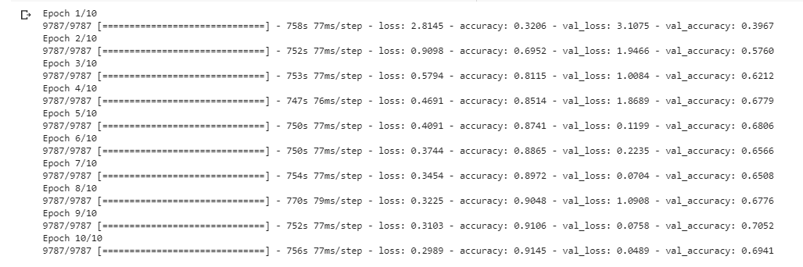
Results - For Baseline CNN
For Baseline CNN
For Baseline CNN, Final Validation accuracy = 69.41 %

Slide 15
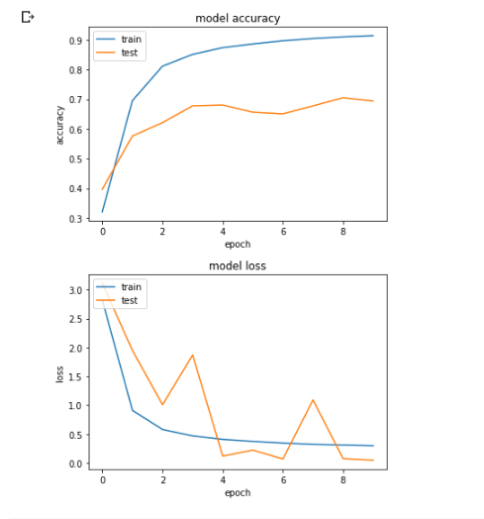
Results - For Baseline CNN
For Baseline CNN
Loss, accuracy v/s Epoch

Slide 16
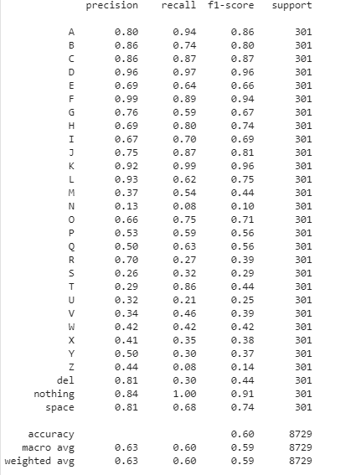
Results -
For Baseline CNN
Precision , recall and F-1 scores
With test accuracy of 60%

Slide 17
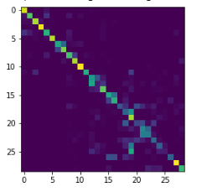
Results - For Baseline CNN
For Baseline CNN
Confusion matrix

Slide 18
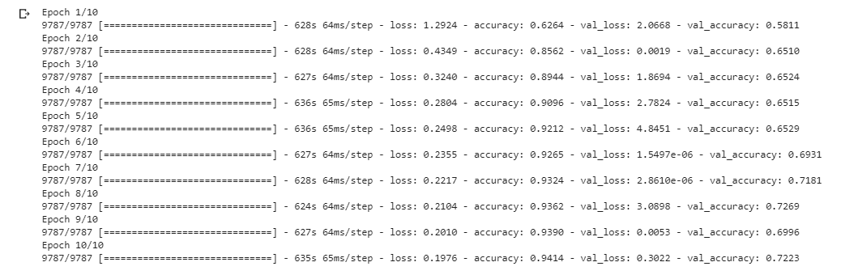
Results - ADCNN
ADCNN
For ADCNN, Final Validation accuracy = 72.23 %

Slide 19
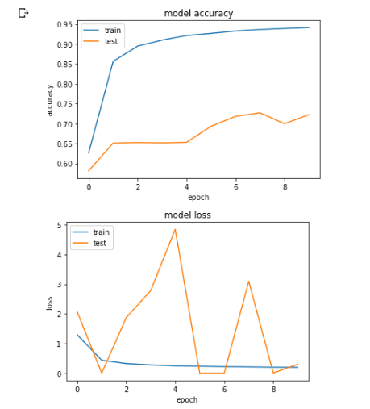
Results - ADCNN
For ADCNN
Loss, accuracy v/s Epoch

Slide 20
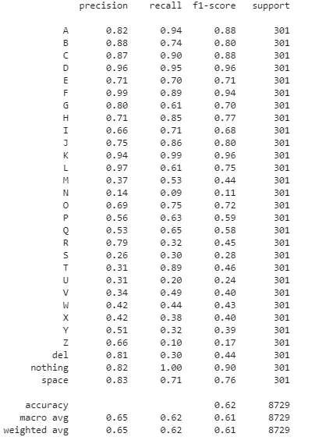
Results -
For Baseline CNN
Precision , recall and F-1 scores
With test accuracy of 62%

Slide 21
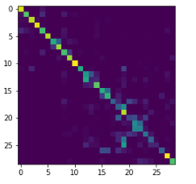
Results - For Baseline CNN
For Baseline CNN
Confusion matrix

